Slide 1
Note-Bridge Group 1
Sprint review 3

Slide 2
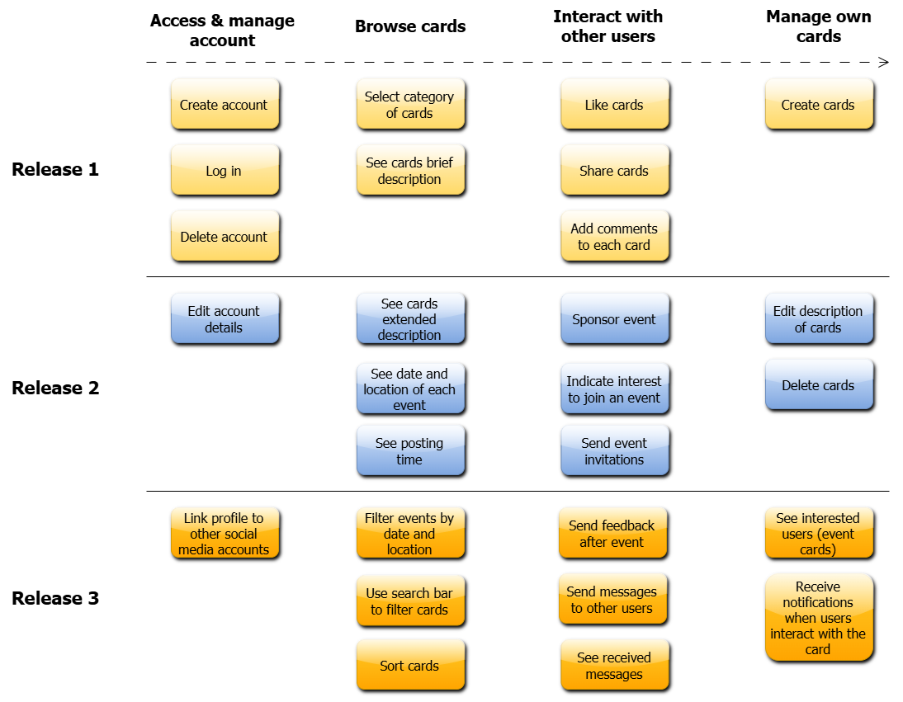
STORY MAP
The color
indicates what we plan to do next
The color
indicates what we have finished for this review
The color
indicates what we have finished past reviews

Slide 3
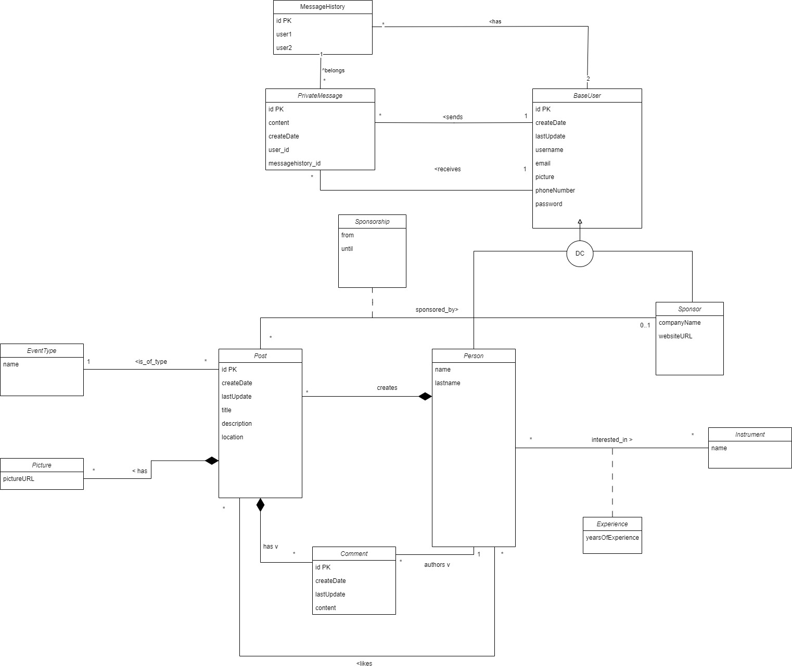

Slide 4
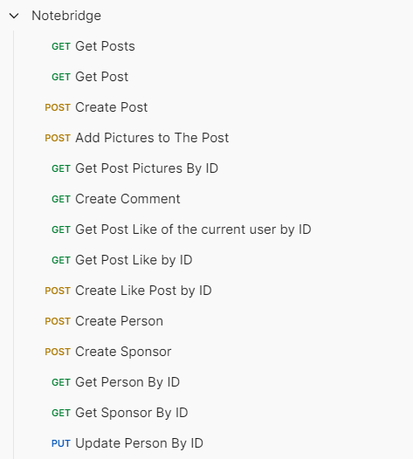
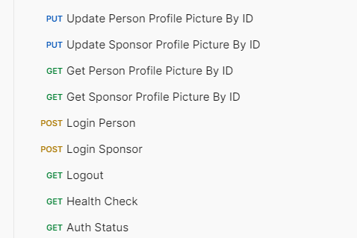
Available Endpoints

Slide 5
DEMO

Slide 6
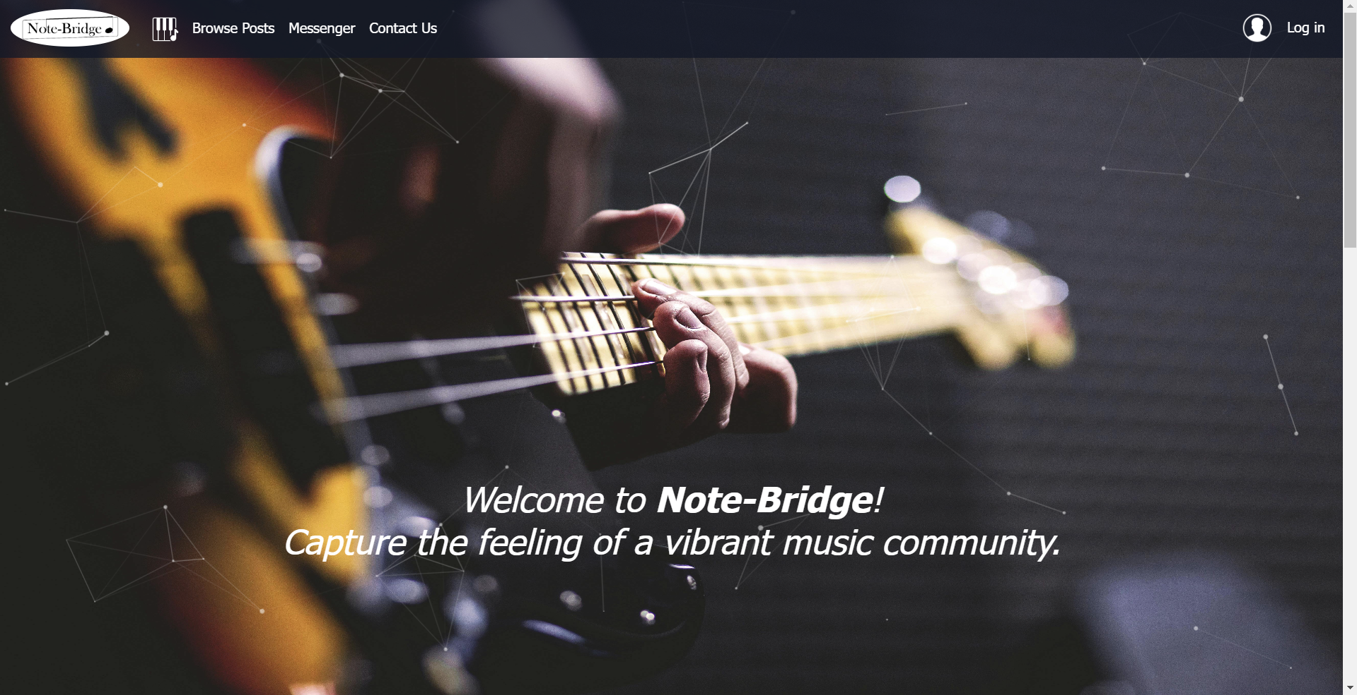
Home Page

Slide 7
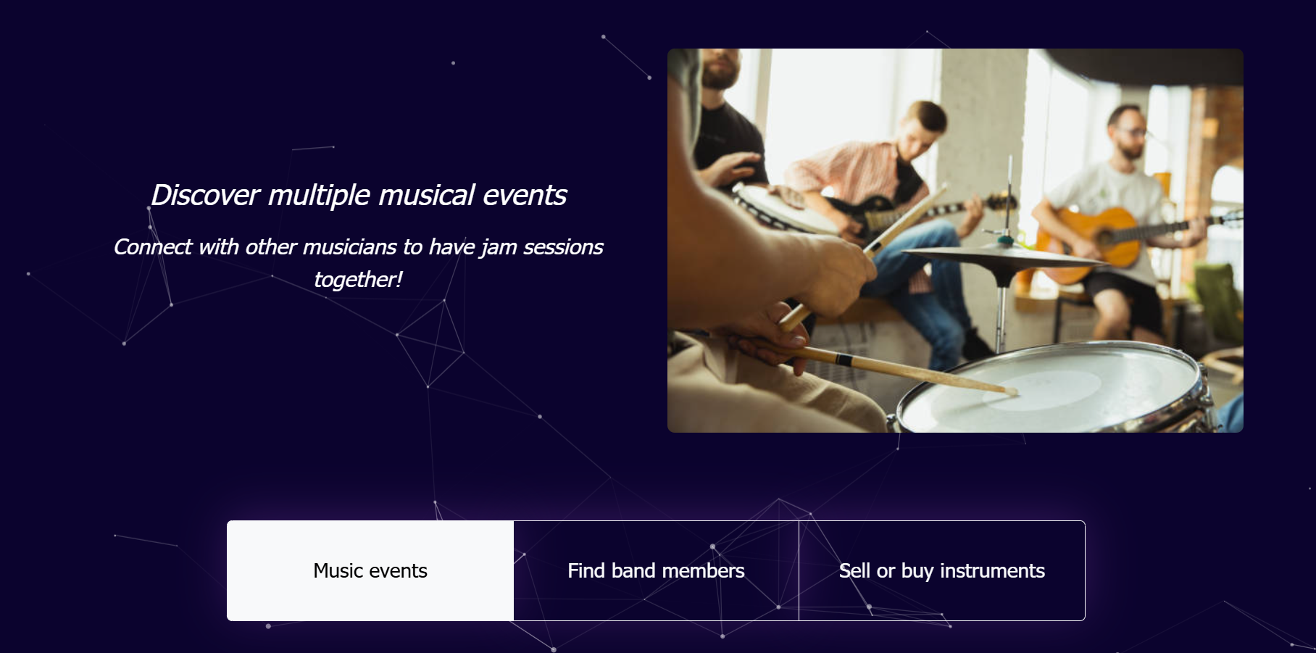
Home Page Continued

Slide 8
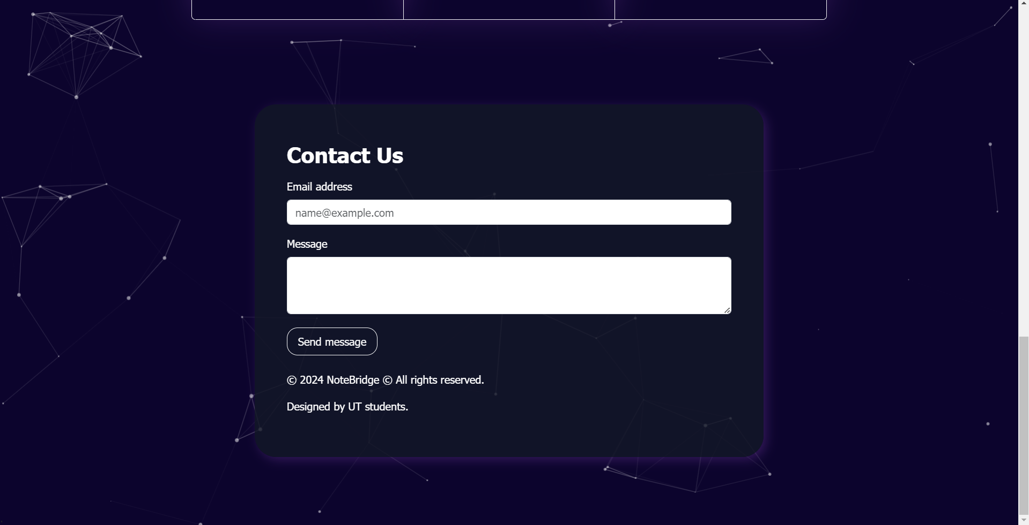
Home Page Continued

Slide 9
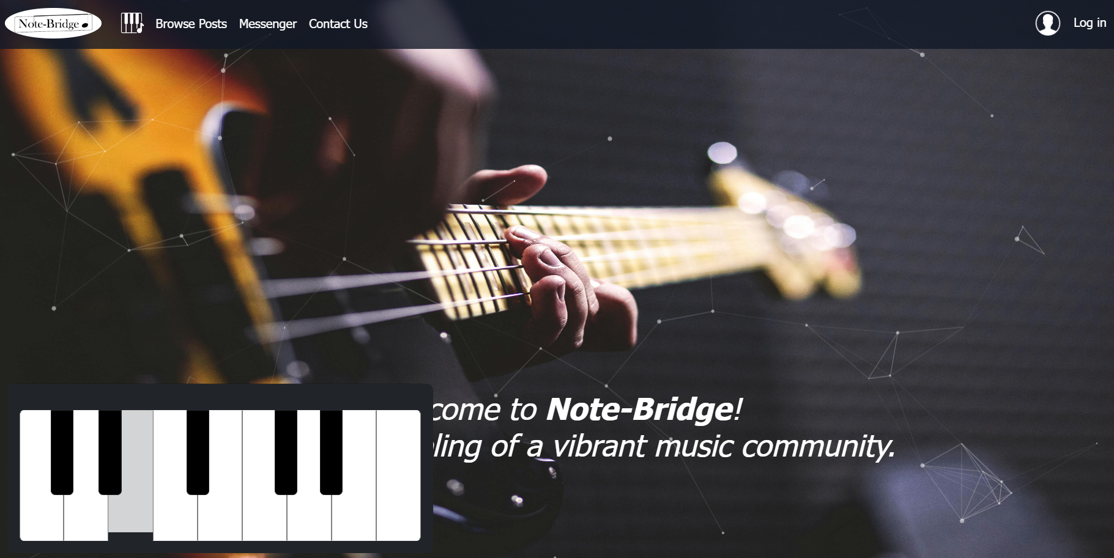
Additional Feature
When you click on the piano image on navigation bar, a playable piano with sound effects appears.

Slide 10
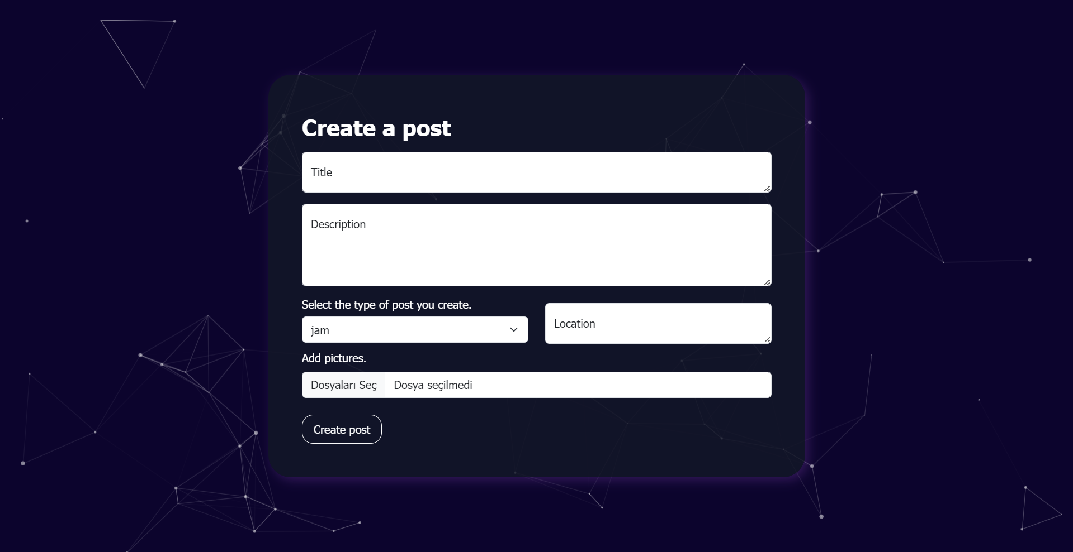
Create Post Page

Slide 11
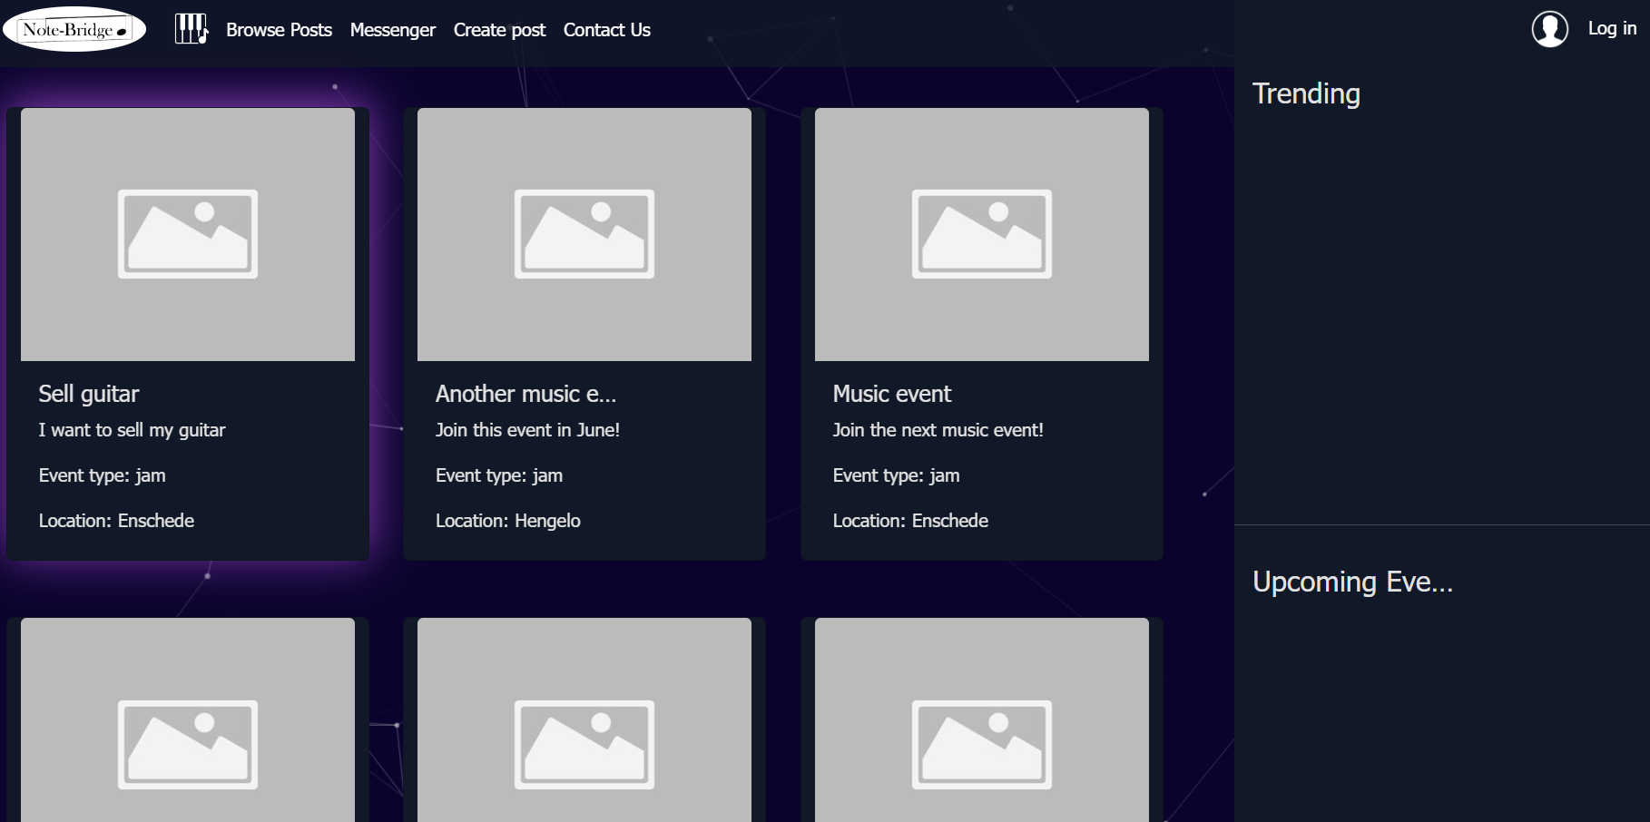
Browse Posts Page

Slide 12
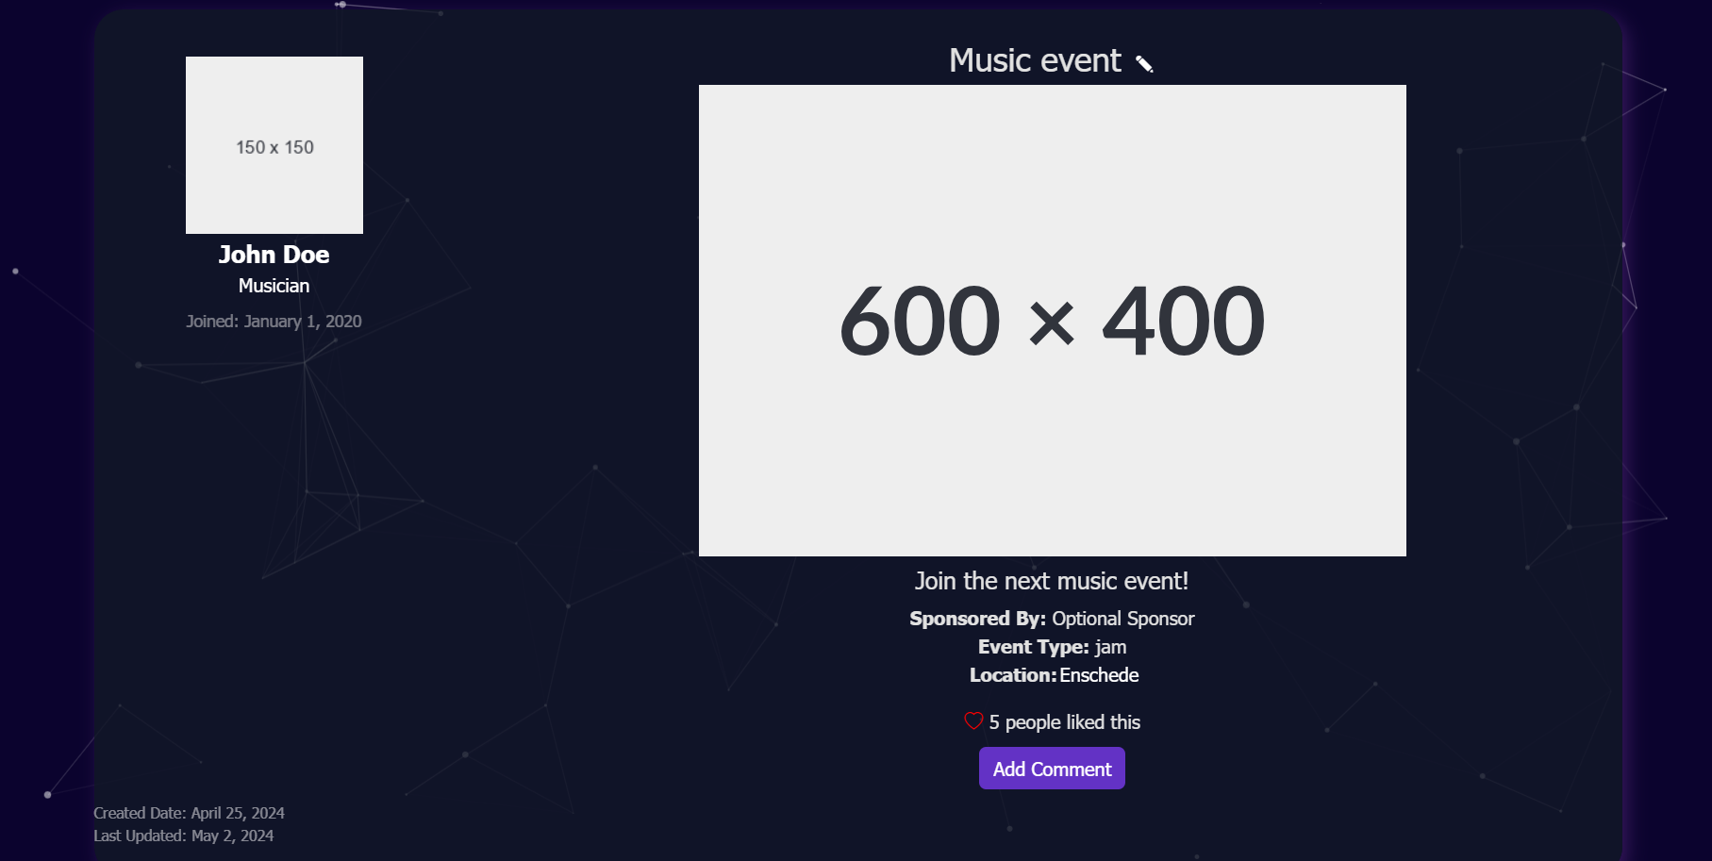
Post Details Page

Slide 13
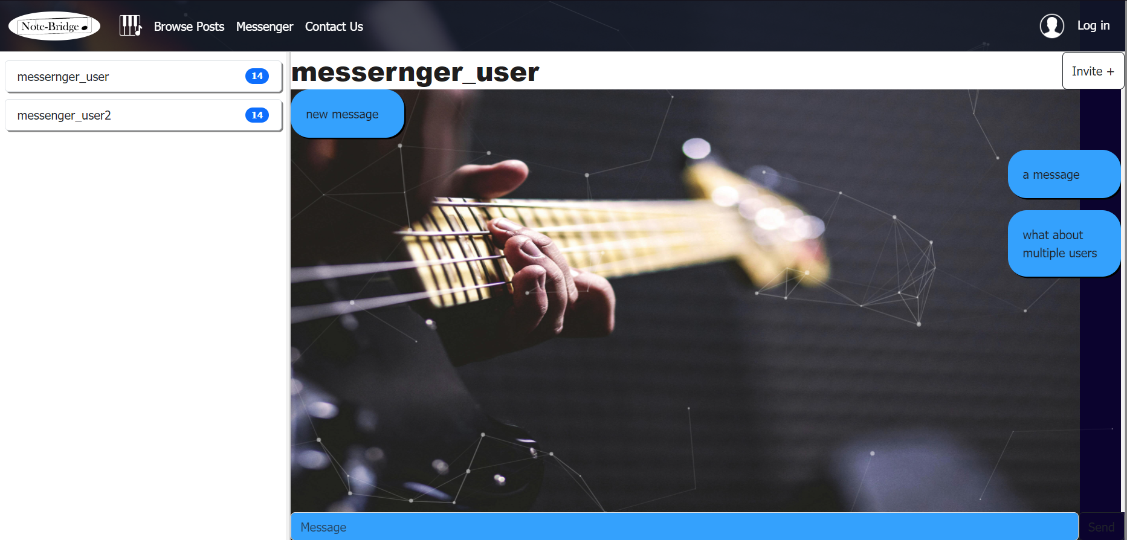
Messenger Page

Slide 14
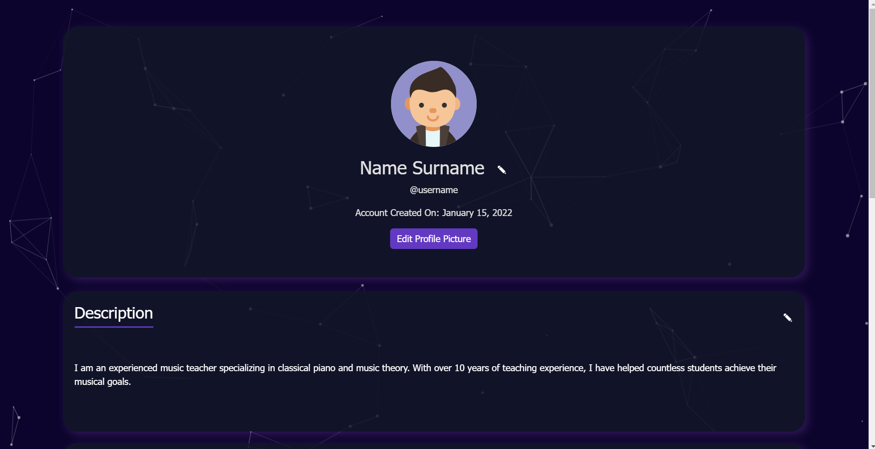
Profile Page

Slide 15
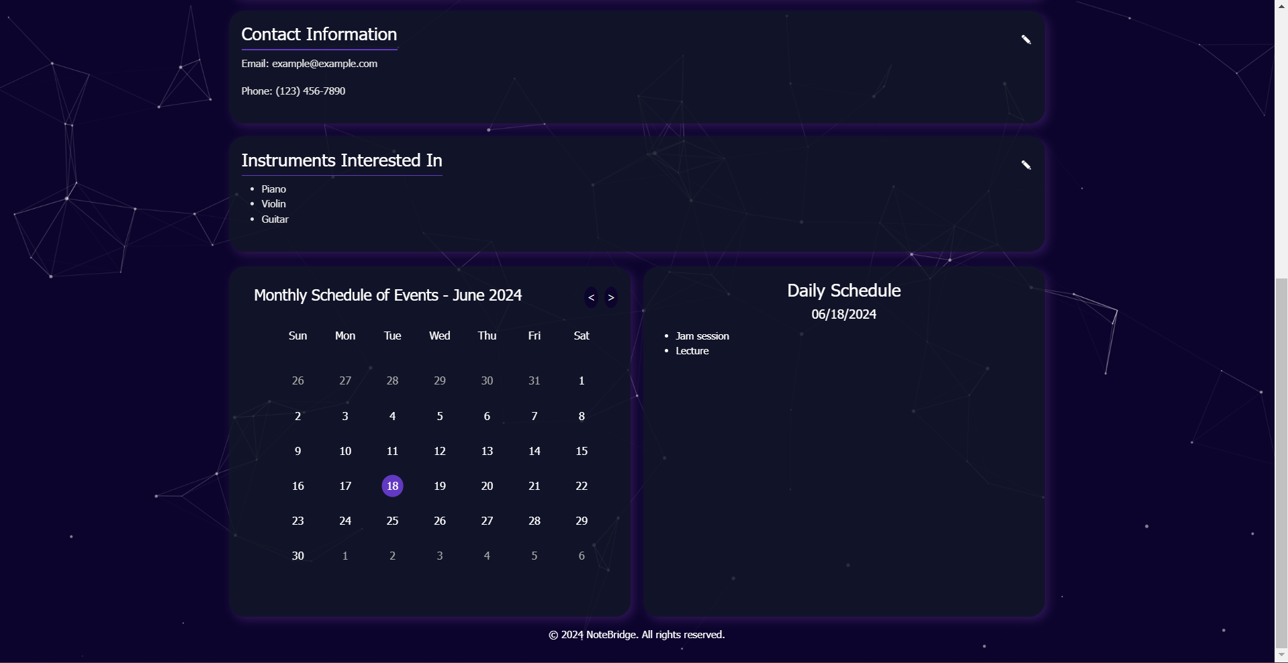
Profile Page Continued
-The scale of the page has been reduced for taking the rest of the page’s screenshot

Slide 16
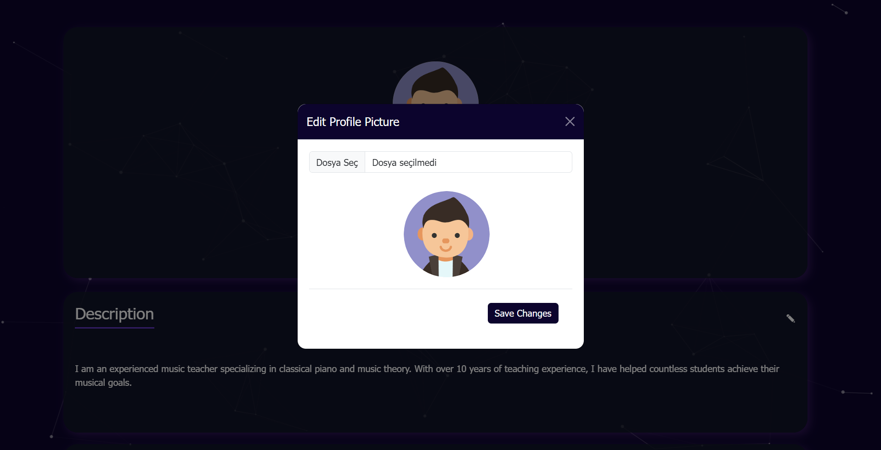
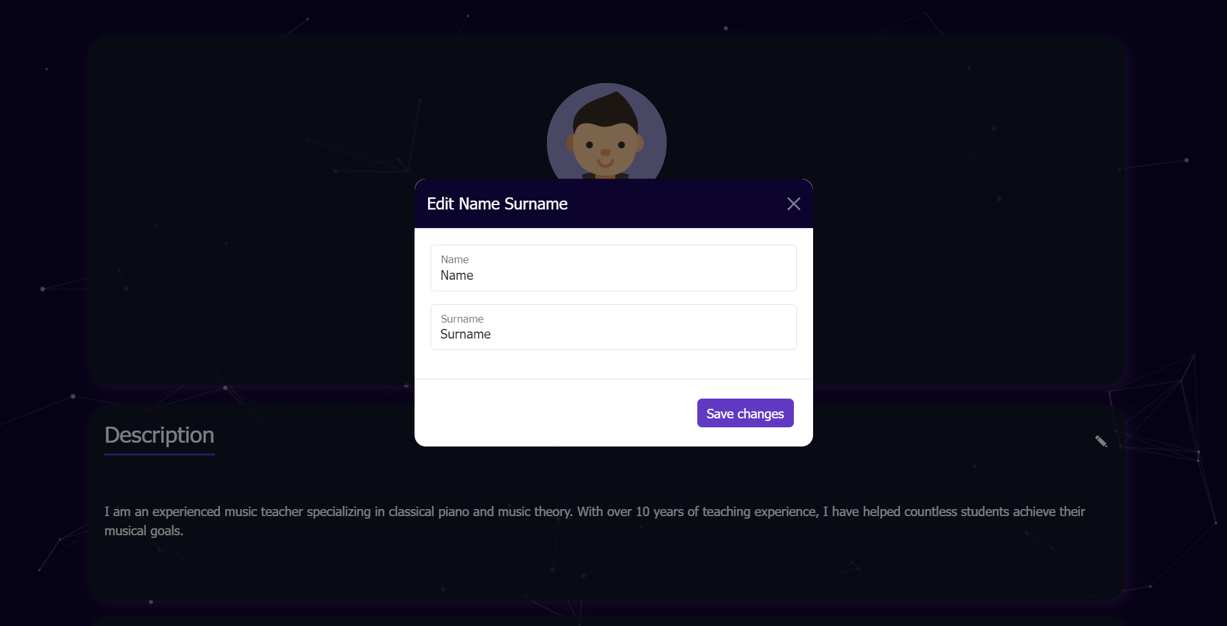
Profile Page Features
Edit profile picture pop up
Edit name surname pop up

Slide 17
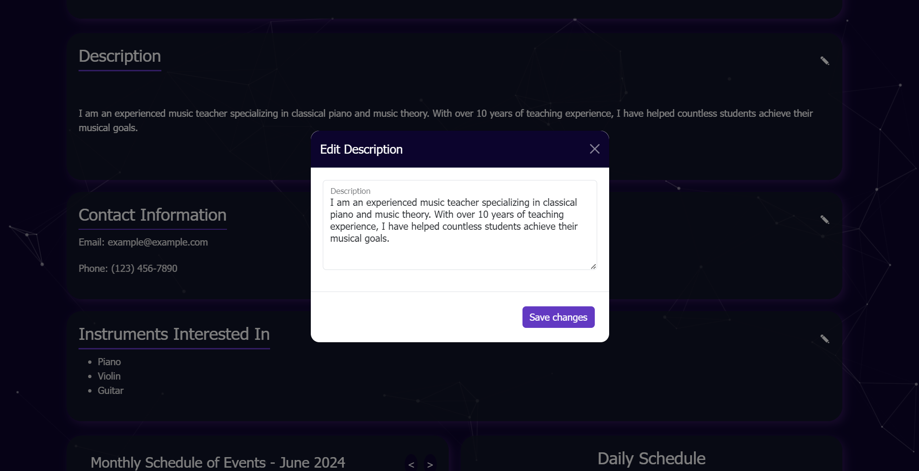
Profile Page Features Continued
Edit pop up for each profile detail(description - contact information- instruments interested in)

Slide 18
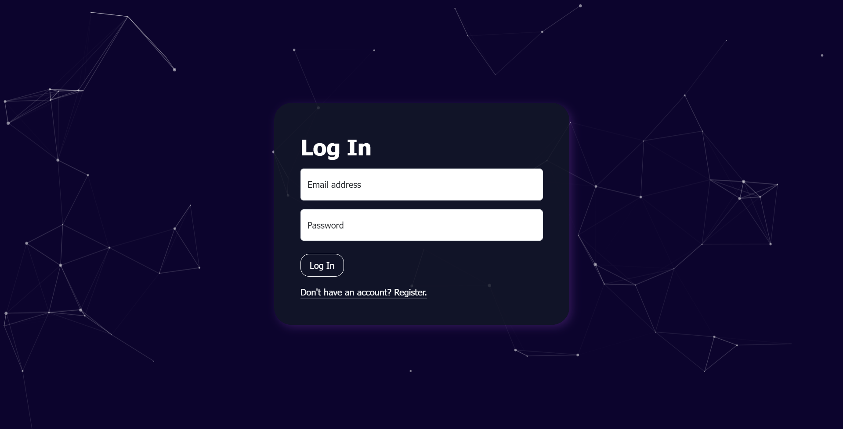
Log In Page

Slide 19
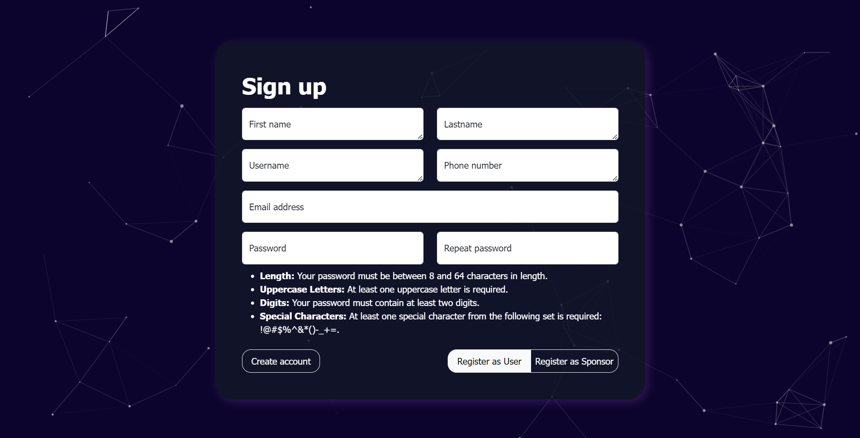
Sign Up Page

Slide 20
Recordings with functionality of the pages

Slide 21
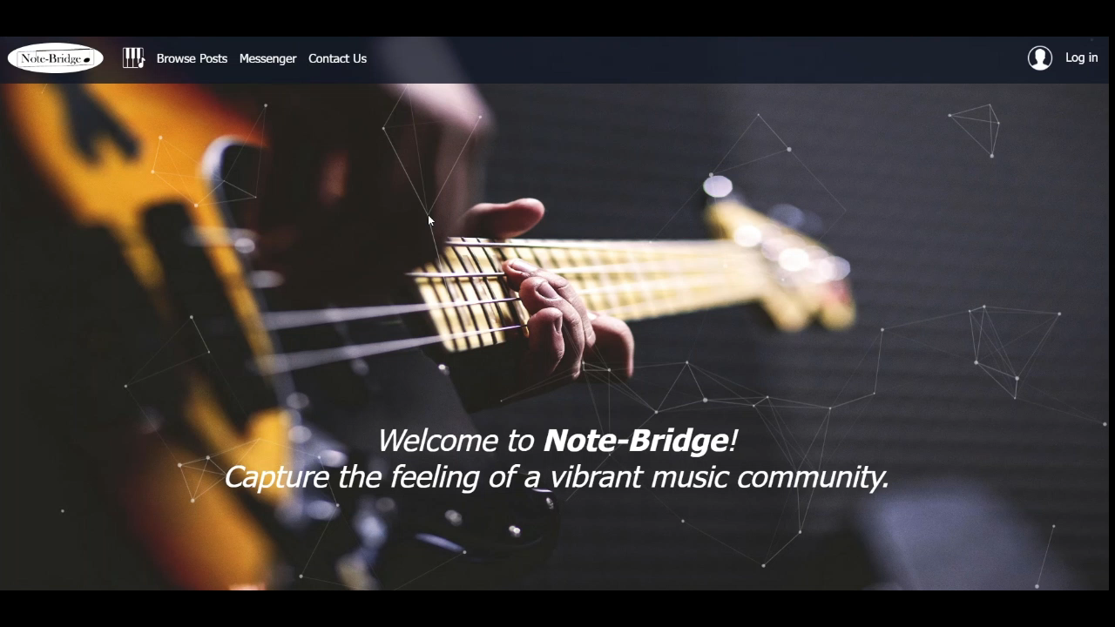
Home page

Slide 22
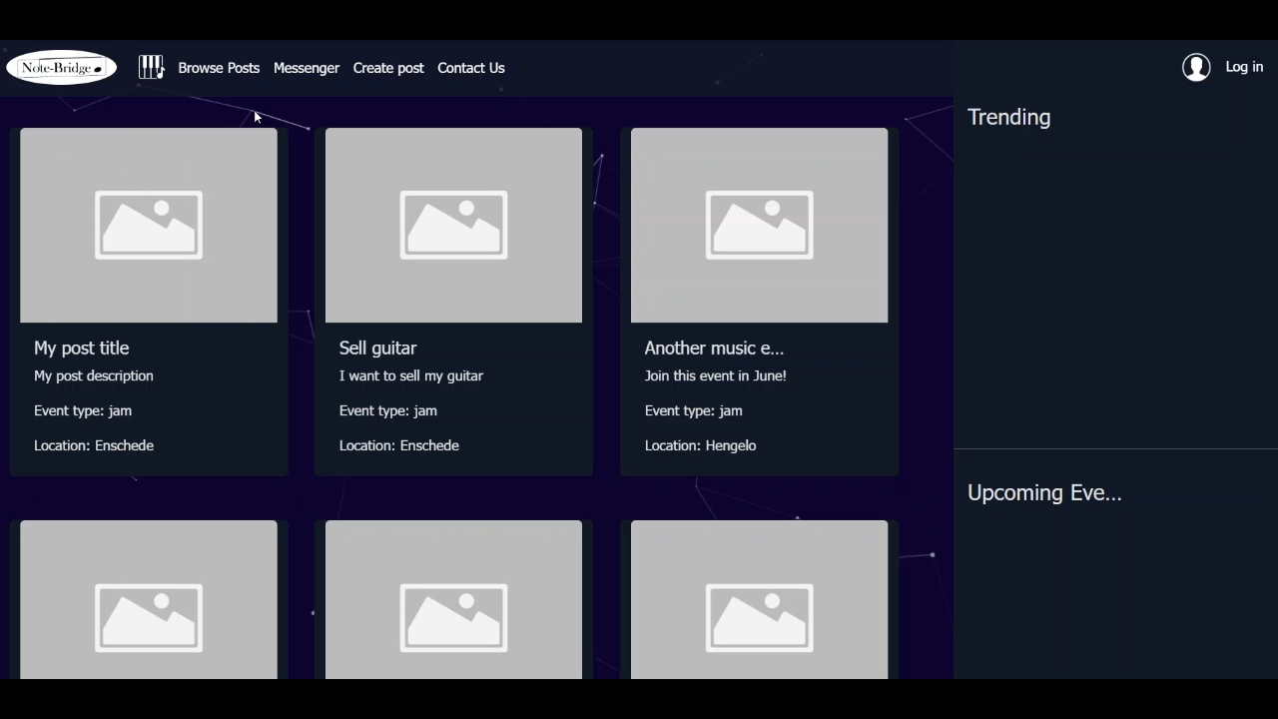
Create a post and view it

Slide 23

Additional feature - Piano animation with sounds

Slide 24
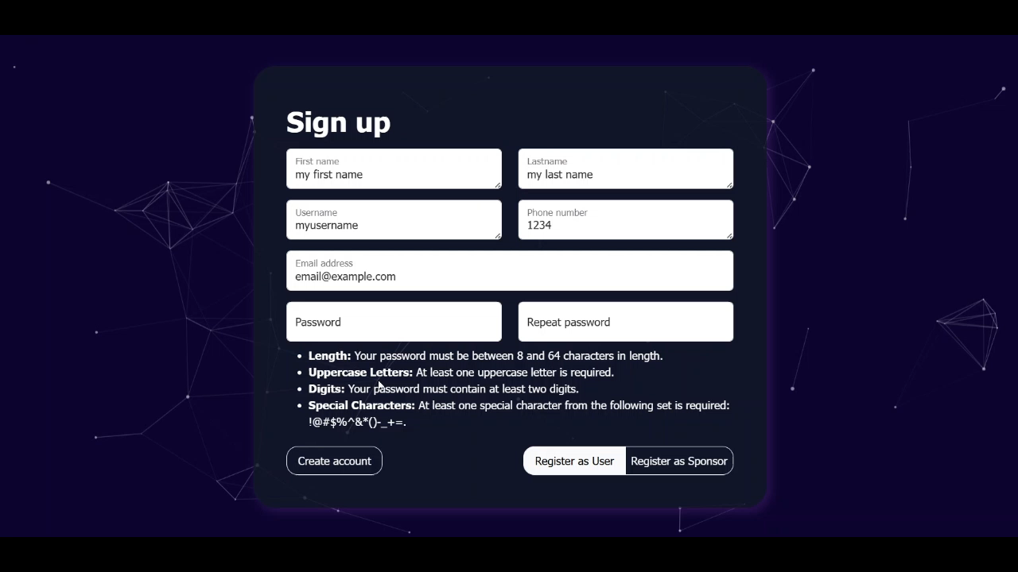
Register

Slide 25
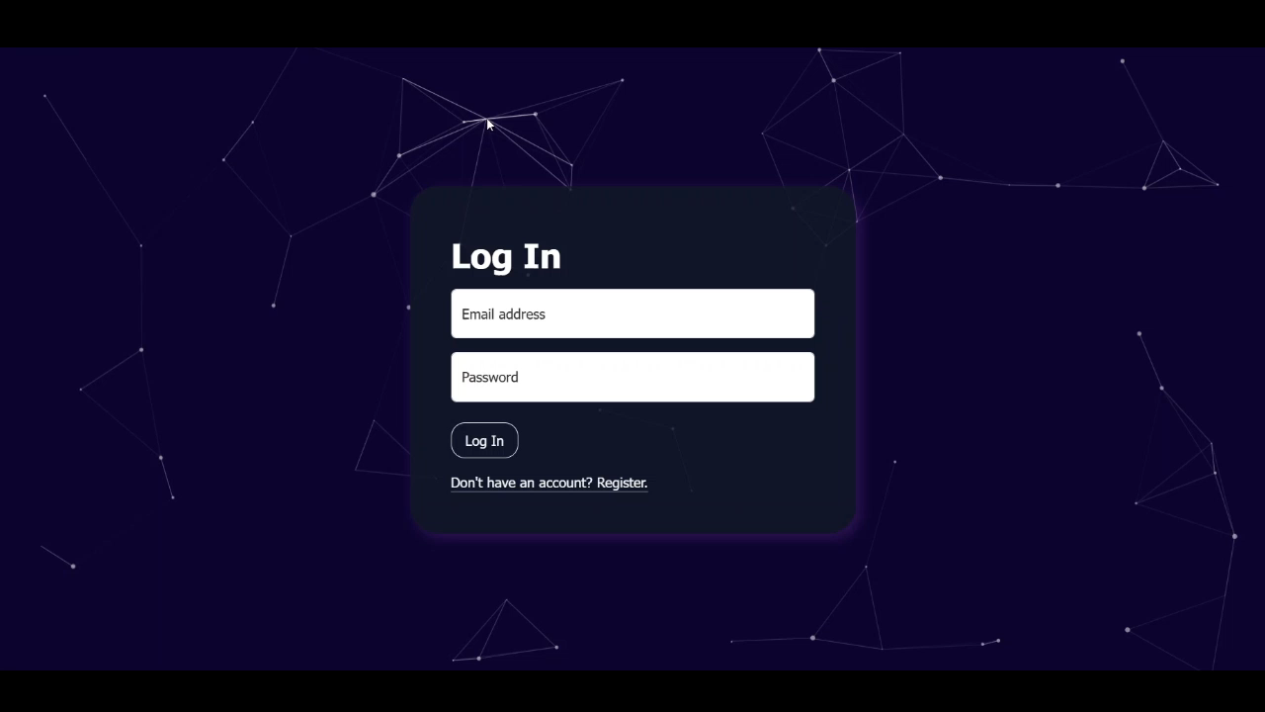
Log in with wrong credentials

Slide 26
Deployed Application
https://notebridge1.paas.hosted-by-previder.com/notebridge/cards.html

Slide 27
Our questions:
What types of cards should exist? At this moment, we have cards for finding band members, jam sessions, music events and selling instruments.
Now, a card displays its title, description, type and location (if it is an event card). We plan to add images and who sponsors it. What other important information should be added?
What filters would you recommend to add?

